Slide 1

Mobile Computing
Bob Marshall, MD MPH MISM FAAFP
DoD Clinical Informatics Fellowship

Slide 2
Learning Objectives
Define mobile computing
Discuss the infrastructure to support mobile computing
Review user interface optimization
Discuss BYOD
Review Mobile Device Management
Search for apps

Slide 3
Definition of Mobile Computing
Mobile Computing is a technology that allows transmission of data, voice and video via a computer or any other wireless enabled device without having to be connected to a fixed physical link. The main concept involves −
Mobile communication (i.e., network/infrastructure)
Mobile hardware (mobile devices…includes phones, tablets, laptops…pretty much anything with a battery and wireless connectivity)
Mobile software

Slide 4
Principles of Mobile Computing
Portability: Facilitates movement of device(s) within the mobile computing environment.
Connectivity: Ability to continuously stay connected with minimal amount of lag/downtime, without being affected by movements of the connected nodes
Social Interactivity: Maintaining the connectivity to collaborate with other users, at least within the same environment.
Individuality: Adapting the technology to suit individual needs

Slide 5
Common Forms
Portable computers
Laptops, notebooks, notepads, etc
Mobile phones
Smartphones, cell phones, feature phones, etc.
Smart cards
Payment, travel and secure area access
Wearable computers
Watches, wristbands, necklaces, keyless implants, etc

Slide 6
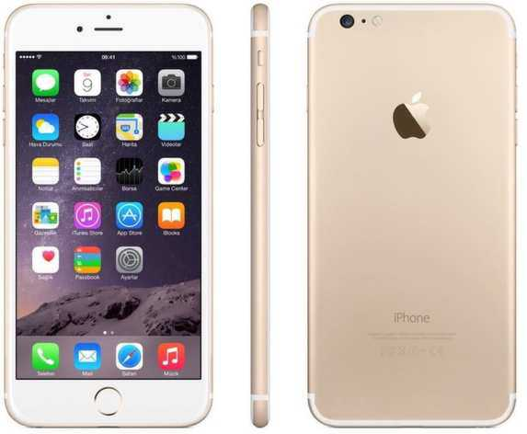
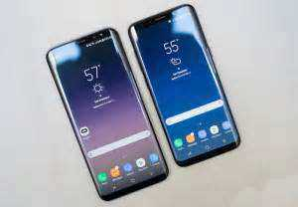
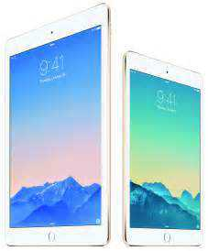

Slide 7
Mobile Computing Limitations
Range and bandwidth
Mobile Internet access is generally slower than direct cable connections
Networks are usually available within range of commercial cell phone towers.
High speed network wireless LANs are inexpensive but have very limited range
Security standards:
When working mobile, one is dependent on public networks, requiring careful use of VPN

Slide 8
Limitations cont.
Power consumption:
When a power outlet or portable generator is not available, mobile computers must rely entirely on battery power
Transmission interferences:
Weather, terrain, and the range from the nearest signal point can all interfere with signal reception.
Reception in tunnels, some buildings, and rural areas is often poor

Slide 9
Limitations cont.
Human interface with device:
Screens and keyboards tend to be small, which may make them hard to use
Potential health hazards:
People who use mobile devices while driving are often distracted from driving and are thus assumed more likely to be involved in traffic accidents
Cell phones may interfere with sensitive medical devices

Slide 10
Mobile Communication
The infrastructure put in place to ensure that seamless and reliable communication goes on
Include devices such as protocols, services, bandwidth, and portals necessary to facilitate and support the stated services
Since the media is unguided/unbounded, the overlaying infrastructure is basically radio wave-oriented
The signals are carried over the air to intended devices that are capable of receiving and sending similar kinds of signals

Slide 11
Mobile Data Communication
Wireless data connections used in mobile computing take three general forms
Cellular data service uses technologies such as GSM, CDMA or GPRS, 3G networks such as W-CDMA, EDGE or CDMA2000 and more recently 4G networks such as LTE, LTE-Advanced
These networks are usually available within range of commercial cell towers.
Wi-Fi connections offer higher performance, may be either on a private business network or accessed through public hotspots, and have a typical range of 100 feet indoors and up to 1000 feet outdoors
Satellite Internet access covers areas where cellular and Wi-Fi are not available and may be set up anywhere the user has a line of sight to the satellite’s location, which for satellites in geostationary orbit means having an unobstructed view of the sky

Slide 12
Mobile Hardware
Mobile hardware includes mobile devices or device components that receive or access the service of mobility
Have a receptor medium that is capable of sensing and receiving signals
Configured to operate in full-duplex, whereby they are capable of sending and receiving signals at the same time
They don't have to wait until one device has finished communicating for the other device to initiate communications

Slide 13
Mobile Software
Mobile software is the actual program that runs on the mobile hardware
It deals with the characteristics and requirements of mobile applications
Includes the operating system of the appliance as well as all the applications that can run on the included OS

Slide 14
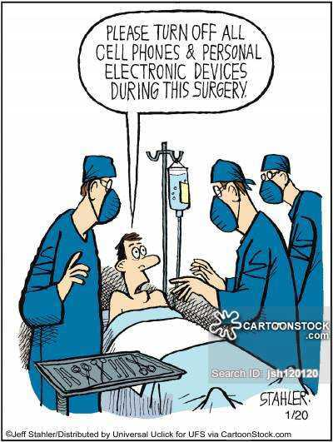

Slide 15
Bring Your Own Device (BYOD)
Refers to the policy of permitting employees to bring personally owned devices (laptops, tablets, and smart phones) to their workplace, and to use those devices to access privileged company information and applications
BYOD usage is primarily driven by perceived end user enjoyment and familiarity with their own devices
Research is divided on benefits
One survey shows around 95% of employees stating they use at least one personal device for work

Slide 16
BYOD Advantages
Some reports have indicated productivity gains by employees
Others say it increases employee morale and convenience by using their own devices and makes the company look like a flexible and attractive employer
A study by IBM says that 82% of employees think that smartphones play a critical role in business
The study also shows benefits of BYOD include increased productivity, employee satisfaction, and cost savings for the company

Slide 17
BYOD Disadvantages 1 of 4
Although the ability to allow staff to work at any time from anywhere and on any device provides real business benefits; it also brings significant risks
According to an IDG survey, more than half of 1,600 senior IT security and technology purchase decision- makers reported serious violations of personal mobile device use
BYOD security relates strongly to the end node problem, wherein a device is used to access both sensitive and risky networks/service risk-averse organizations issue devices specifically for Internet use (this is termed Inverse-BYOD)

Slide 18
BYOD Disadvantages 2 of 4
Organizations who wish to adopt a BYOD policy must consider how they will ensure that the devices which connect to the organization's network infrastructure to access sensitive information will be protected from malware
Software developers and device manufacturers constantly release security patches due to daily increase in the number of threats from malware
IT departments that support organizations with a BYOD policy must be prepared to have the necessary systems and processes in place that will apply the patches to protect systems against the known vulnerabilities to the various devices that users may choose to use

Slide 19
BYOD Disadvantages 3 of 4
Several market and policies have emerged to address BYOD security concerns, including mobile device management (MDM), containerization and app virtualization
A key issue of BYOD which is often overlooked is BYOD’s phone number problem, which raises the question of the ownership of the phone number
Firms need an efficient inventory management system that keeps track of which devices employees are using, where the device is located, whether it is being used, and what software it is equipped with

Slide 20
BYOD Disadvantages 4 of 4
A challenging but important task for companies who utilize BYOD is to develop a policy that defines exactly what sensitive company information needs to be protected and which employees should have access to this information, and then to educate all employees on this policy
Another important issue with BYOD is of scalability and capability
Finally, there is confusion regarding the reimbursement for the use of a personal device

Slide 21
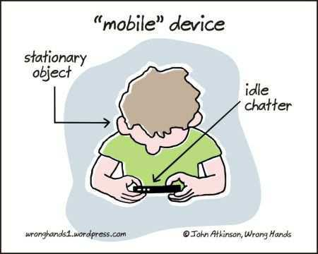

Slide 22
Mobile Device Management
Mobile device management (MDM) is an industry term for the administration of mobile devices, such as smartphones, tablet computers, laptops and desktop computers
MDM primarily deals with corporate data segregation, securing emails, securing corporate documents on device, enforcing corporate policies, integrating and managing mobile devices including laptops and handhelds of various categories
MDM implementations may be either on-premises or cloud-based

Slide 23
MDM Overview 1 of 2
MDM functionality can include over-the-air distribution of applications, data and configuration settings for all types of mobile devices, including mobile phones, smartphones, tablet computers, ruggedized mobile computers, mobile printers, mobile POS devices, etc
By controlling and protecting the data and configuration settings of all mobile devices in a network, MDM can reduce support costs and business risks
The intent of MDM is to optimize the functionality and security of a mobile communications network while minimizing cost and downtime

Slide 24
MDM Overview 2 of 2
Solutions typically include a server component, which sends out the management commands to the mobile devices, and a client component, which runs on the managed device and receives and implements the management commands
Device management software platforms ensure that end users benefit from plug and play data services for whatever device they are using
Such a platform can automatically detect devices in the network, sending them settings for immediate and continued usability

Slide 25
Device Mgmt Specifications
The Open Mobile Alliance (OMA) specified a platform-independent device management protocol called OMA Device Management
Smart message is text SMS-based provisioning protocol (service settings like: ftp, telnet, SMSC number, email settings, etc...)
OMA Client Provisioning is a binary SMS-based service settings provisioning protocol
Over-the-air programming (OTA) capabilities are considered a main component of mobile network operator and enterprise-grade mobile device management software

Slide 26
Enterprise use of MDM
All MDM products are built with an idea of Containerization
The MDM Container is secured using the latest cryptographic techniques (AES-256 or more preferred)
Corporate data such as email, documents, and enterprise applications are encrypted and processed inside the container
This ensures that corporate data is separated from user’s personal data on the device
Additionally, encryption for the entire device and/or SD Card can be enforced depending on MDM product capability

Slide 27
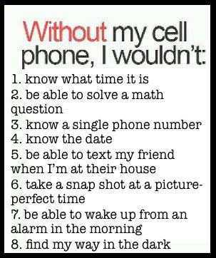

Slide 28
User Interface Issues
A mobile user interface (mobile UI) is the graphical and usually touch-sensitive display on a mobile device, such as a smartphone or tablet, that allows the user to interact with the device’s apps, features, content and functions
The smaller screen size and touch screen controls create special considerations in UI design to ensure usability, readability and consistency

Slide 29
Mobile Security – The Problem
Number of mobile phone users by 2019: > 5 billion
Android malware: ZNIU (> 300,000 phones affected)
iOS Malware: iXintpwn/YJSNI (crashes iOS devices)
Ransomware: > 235,000 phones affected in the first half of 2017 – more than double that for all of 2016
McAfee Labs: 16 million malware incidents combined (all mobile devices) for 2017

Slide 30
Five New Threats
Persistent, enterprise-class spyware
Mobile botnets
Ad and click fraud → malicious app download
IoT – malware in its infancy, but bad actors are certainly making a go of it
Dead apps (see below under Best Practices)

Slide 31
Some Security Best Practices 1 of 2
Regularly update the OS and apps
Use relevant built-in security features
Regularly review and limit app permissions to only those needed to work – basic permissions
Limit the amount of access apps have or can display when the device is locked
Minimize location access – limit to only while using the app
Avoid unsecured Wi-Fi networks
Only download apps from trusted sources

Slide 32
Some Security Best Practices 2 of 2
Know the risks of jailbreaking/rooting – this removes security limitations placed by manufacturers, leaving the system more vulnerable
Be wary of unsolicited calls or messages
Set automatic locks on mobile devices
Limit the personal information given to apps and websites
Manage what is shared online

Slide 33
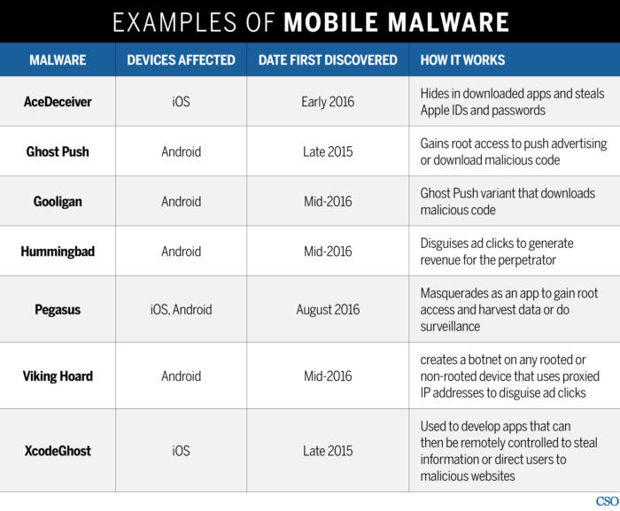

Slide 34
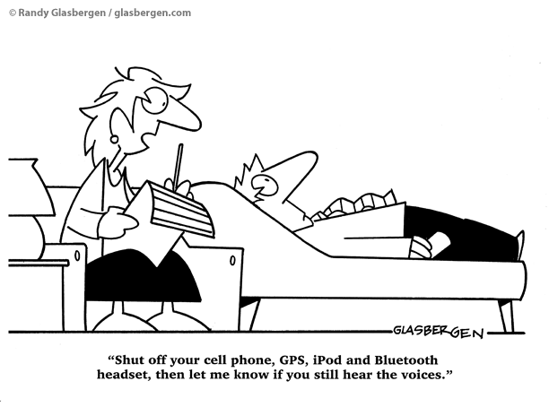

Slide 35
Mobile UI Best Practices
The layout of the information, commands, and content in an app should echo those of the operating system in placement, composition and colors
While apps may diverge to some degree in style, consistency on most of these points allows users to intuit or at least quickly learn how use an interface
Click points must be usable for touch-based selection with a finger
This means a click point can't be too small or narrow in any direction, to avoid unwanted selection of nearby items, sometimes referred to as “fat fingering”

Slide 36
Mobile UI Best Practices
Maximize the content window size
On small screens, the UI should not unnecessarily dominate screen size. It’s important to recognize that the object of a UI is to facilitate use of content and apps, not just use of the interface
The number of controls or commands displayed at any given time should be appropriate to avoid overwhelming the user or making viewing/interacting with content confusing

Slide 37

Questions??

